Slide 1
Best First Search (Heuristic, Greddy)

Slide 2
EXAMPLE

Slide 3
EXAMPLE
A
B
C
D
E
F
G
H
I
J
K
L
M
N
O

Slide 4
COST OF EACH STATE TRANSITION
A
22
12
B
C
1
10
5
8
D
E
F
G
50
60
50
60
4
9
1
2
H
I
J
K
L
M
N
O

Slide 5
FINDING THE SHORTEST PATH
A
22
12
B
C
1
10
5
8
D
E
F
G
50
60
50
60
4
9
1
2
H
I
J
K
L
M
N
O

Slide 6
BEST-FIRST SEARCH (HEURISTIC)
A
22
12
B
C
1
10
5
8
D
E
F
G
50
60
50
60
4
9
1
2
H
I
J
K
L
M
N
O

Slide 7
BEST-FIRST SEARCH (HEURISTIC)
A
A
22
12
B
C
1
10
5
8
D
E
F
G
50
60
50
60
4
9
1
2
H
I
J
K
L
M
N
O

Slide 8
BEST-FIRST SEARCH (HEURISTIC)
22 > 12
A
A
22
12
B
C
1
10
5
8
D
E
F
G
50
60
50
60
4
9
1
2
H
I
J
K
L
M
N
O

Slide 9
BEST-FIRST SEARCH (HEURISTIC)
22 > 12
A
A
C
22
12
B
C
1
10
5
8
D
E
F
G
50
60
50
60
4
9
1
2
H
I
J
K
L
M
N
O

Slide 10
BEST-FIRST SEARCH (HEURISTIC)
5 < 8
A
A
C
22
12
B
C
1
10
5
8
D
E
F
G
50
60
50
60
4
9
1
2
H
I
J
K
L
M
N
O

Slide 11
BEST-FIRST SEARCH (HEURISTIC)
5 < 8
A
A
C
22
12
F
B
C
1
10
5
8
D
E
F
G
50
60
50
60
4
9
1
2
H
I
J
K
L
M
N
O

Slide 12
BEST-FIRST SEARCH (HEURISTIC)
4 < 9
A
A
C
22
12
F
B
C
1
10
5
8
D
E
F
G
50
60
50
60
4
9
1
2
H
I
J
K
L
M
N
O

Slide 13
BEST-FIRST SEARCH (HEURISTIC)
4 < 9
A
A
C
22
12
F
L
B
C
1
10
5
8
D
E
F
G
50
60
50
60
4
9
1
2
H
I
J
K
L
M
N
O

Slide 14
IS THIS THE BEST SOLUTION?
A
A
C
22
12
F
L
B
C
1
10
5
8
D
E
F
G
50
60
50
60
4
9
1
2
H
I
J
K
L
M
N
O
Costs:
[73]
[83]
[82]
[92]
[21]
[26]
[21]
[22]

Slide 15
ANOTEHR EXAMLE
A
A
C
22
12
F
L
B
C
1
10
5
8
D
E
F
G
50
60
50
60
50
100
1
2
H
I
J
K
L
M
N
O
Costs:
[73]
[63]
[82]
[92]
[67]
[117]
[21]
[22]

Slide 16
PROS AND CONS
Advantages:
Fast
Computationally cheap
Easy to implement (no queue, no stack)
Drawbacks:
Does not always find the best solution
Requires heuristic information

Slide 17
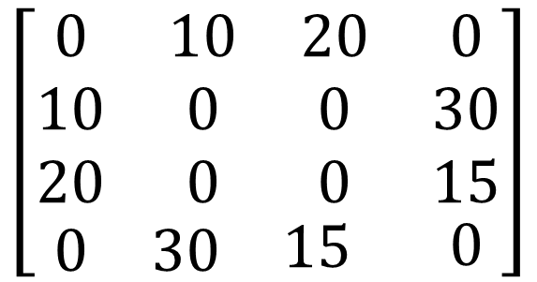
IMPLMENTATION
1
10
20
2
3
30
15
4
1
2
3
4
We need a cost matrix
1
$$\left[\begin{matrix}\begin{matrix}\begin{matrix}\begin{matrix}0 \\ 10 \\ 20\end{matrix} & \begin{matrix}10 \\ 0 \\ 0\end{matrix}\end{matrix} & \begin{matrix}20 \\ 0 \\ 0\end{matrix}\end{matrix} & \begin{matrix}0 \\ 30 \\ 15\end{matrix} \\ \begin{matrix}\begin{matrix}0 & 30\end{matrix} & 15\end{matrix} & 0\end{matrix}\right]$$
2
3
4

